Slide 1

Computer Communications
& Networks
CSNC-2413
Week: 5
Computer Networking: A Top Down Approach
6th edition
Jim Kurose, Keith Ross
Addison-Wesley
March 2012
Web & HTTP
Dr Nauman Mazhar
Faculty of Information Technology (FIT)
University of Central Punjab (UCP)

Slide 2
Chapter 2: outline
2.1 Principles of network applications
2.2 Web and HTTP
2.3 FTP
2.4 Electronic mail
  SMTP, POP3
2.5 DNS
2.6 P2P applications
2.7 Socket programming with UDP and TCP

Slide 3
Web and HTTP
web page consists of a base HTML file, which may include several referenced objects
objects can be – HTML file, JPEG image, audio file, JavaScript, etc
each object has an address – identified by a URL
www.someschool.edu /someDept/page.html
host name
path
web surfing involves fetching & displaying these various objects
  needs a protocol – HTTP

Slide 4


HTTP overview
HTTP: Hypertext Transfer Protocol
Appl layer protocol for Web
HTTP implemented in two
programs…
  Client (browser) requests
  web objects
  Server sends objects in response
HTTP defines messages exchanged between client/server
  structure of msgs
  sequence of msgs
HTTP request
PC running
Chrome browser
HTTP response
HTTP request
server
running
Apache Web
server
HTTP response
iphone running
Safari browser

Slide 5
HTTP over TCP
HTTP uses TCP:
HTTP client initiates TCP connection to server at port 80
HTTP server accepts TCP connection from client
HTTP client/server then access TCP thru their socket interfaces
  send/recv HTTP messages
TCP provides reliable delivery of HTTP messages
  HTTP need not worry about pkt loss, re-ordering
HTTP is “stateless”
server maintains no info about past client requests
simple design
aside
protocols that maintain “state” are complex!
need to maintain past
history (state)

Slide 6
HTTP connection types
Non-persistent HTTP
TCP connection opened to send HTTP Request
closed by server, after servicing the request
at most one object sent over a single TCP connection
downloading multiple objects requires opening multiple TCP connections
Persistent HTTP
TCP connection is opened to send HTTP Request
remains open for subsequent requests, too
multiple objects can be sent over single TCP connection between client & server

Slide 7
Non-persistent HTTP
(contains text,
& references to 10
jpeg images)
suppose user enters URL:
www.someSchool.edu /someDept/page.html
1a. HTTP client initiates TCP connection to HTTP server at host www.someSchool.edu
on port 80
1b. HTTP server at host www.someSchool.edu
waiting for TCP connection at port 80; “accepts” connection, notify client
2. HTTP client sends HTTP
request message (containing URL) into TCP socket;
Message indicates that client wants the object
someDept/page.html
3. HTTP server receives request message,
forms response message containing the object,
& sends message into its socket
time

Slide 8
Non-persistent HTTP
4. HTTP server closes TCP connection
5. HTTP client receives response message containing html file,
displays html
Parses html file, finds 10 referenced jpeg objects
time
6. Steps 1- 5 repeated for each of 10 jpeg objects

Slide 9
Non-persistent HTTP: response time
RTT : time for a small packet to travel from client to server, & back
HTTP response time:
1 RTT to initiate TCP conn
1 RTT for HTTP request &
first few bytes of HTTP
response to return
file Tx time
Non-persistent HTTP response
time =
  2RTT+ file Tx time
initiate TCP
connection
RTT
request
file
time to
Tx
file
RTT
file
received
time
time

Slide 10
HTTP response times
Persistent HTTP:
server leaves TCP connection open after sending response
subsequent HTTP messages between same client/server sent over open connection
client sends requests as soon as it encounters a referenced object
as little as 1 RTT for all the referenced objects
in addition to 1 RTT for initial connection setup
Non-persistent HTTP issues:
requires, at minimum,
2 RTTs per object
OS overhead for each TCP connection
browsers often open parallel TCP connections to fetch referenced objects

Slide 11
Practice problems
Consider a user browsing the web. He opens a website, whose web page has 5 objects, including the base html file. The RTT between client & server is 4 msec. Also, transmission time for each object on server is 25 msec. Compute the total delay experienced by the user to view the web page, if he uses persistent HTTP.
A browser opens the web page of a server. Web page references 02 objects; 01 located on the same server, and 01 at another web server. Assuming RTT value of 3 msec for connection setup as well as for each request, an object transmission time of 8 msec, and use of non-persistent HTTP, how much time will be taken to completely download and display the complete web page.

Slide 12
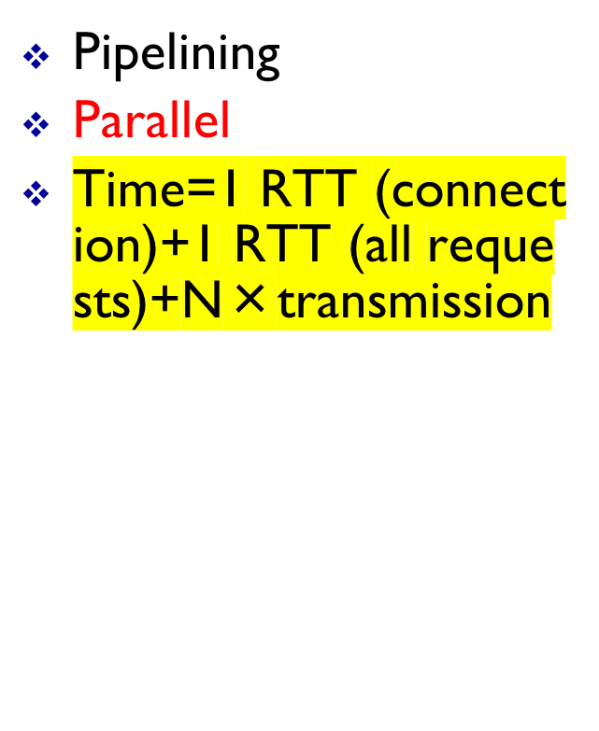
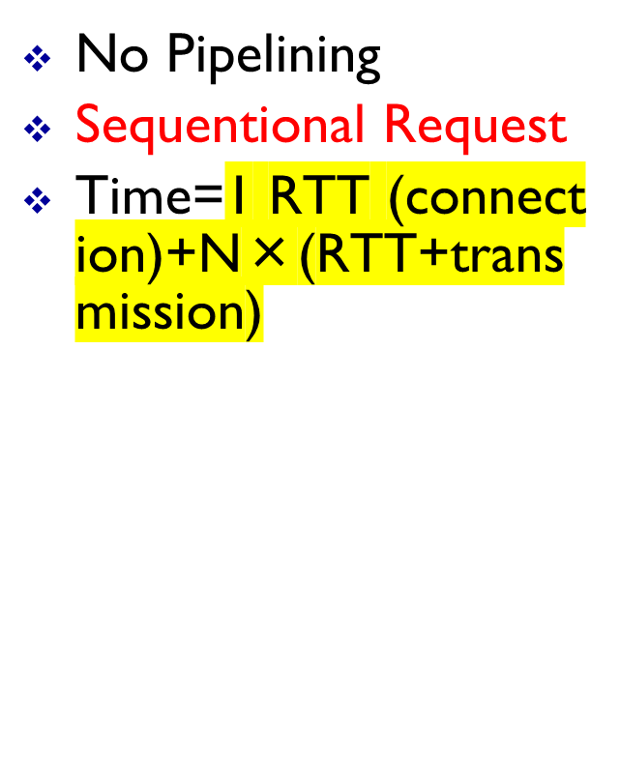
Formula Persistent pipe/no-pip
Introduction
2-<number>

Slide 13
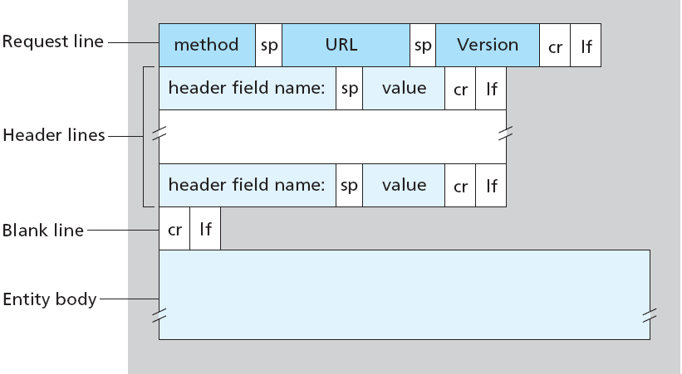
HTTP request message
Two types of HTTP messages: Request, Response
HTTP Request Message general format

Slide 14
HTTP request message
HTTP Request message - Example:
  ASCII (human-readable format)
If user enters URL:
www.someSchool.edu /someDept/page.html
carriage return character
request line
(GET, POST,
HEAD methods)
line-feed character
GET /someDept/page.html HTTP/1.1\r\n
Host: www.someSchool.edu\r\n
Connection: close\r\n
User-Agent: Mozilla/4.0\r\n
Accept-Language: fr\r\n
\r\n
header
lines
carriage return,
line feed at start
of line indicates
end of header lines

Slide 15
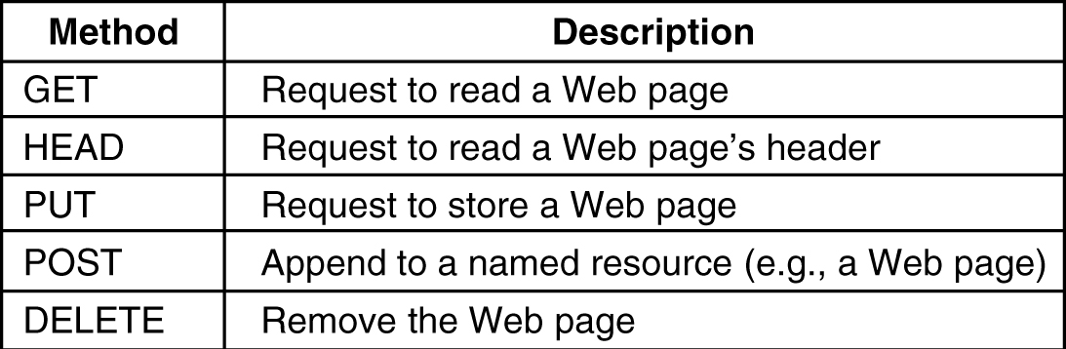
HTTP Methods
Some of the common HTTP Request methods…

Slide 16
Uploading form input
Web pages often include form input (e.g, user input data)
(how is this info sent to server…)
POST method
Request line contains the POST method
input is uploaded to server in entity body
URL method
Request line contains the GET method
input is uploaded in URL field of request line
GET /animalsearch?animal=monkeys&food=banana HTTP/1.1
/animalsearch → form’s action animal, food → query parameters

Slide 17
Method types
HTTP/1.0
GET
POST
HEAD
HTTP/1.1
GET, POST, HEAD
PUT
  uploads file in entity body to path specified in URL field
DELETE
  deletes file specified in the URL field

Slide 18
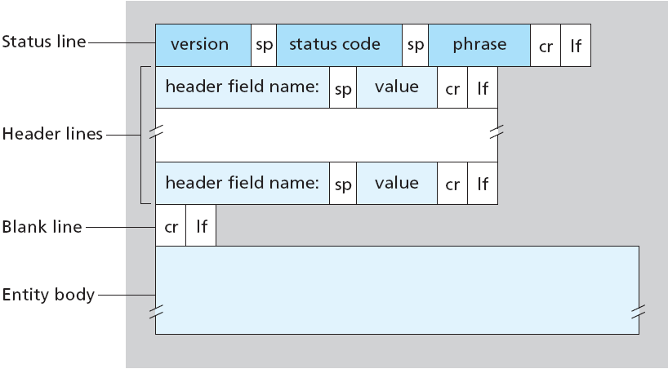
HTTP response message: general format

Slide 19
HTTP response message
status line
(version,
status code,
status phrase)
HTTP/1.1 200 OK\r\n
Connection: close\r\n
Date: Sat, 07 Jul 2007 12:00:15 GMT\r\n
Server: Apache/1.3.0 (Unix)\r\n
Last-Modified: Sun, 06 May 2007 09:23:24 GMT\r\n
Content-Length: 6821\r\n
Content-Type: text/html\r\n
\r\n
data data data data data ...
header
lines
data, e.g,
requested
HTML file

Slide 20
HTTP response status codes
status code appears in first line of response message
some sample codes:
200 OK
request succeeded, requested object later in this msg
301 Moved Permanently
requested object moved
new location specified later in this msg (Location:)
400 Bad Request
request msg not understood by server
404 Not Found
requested document not found on this server
505 HTTP Version Not Supported

Slide 21
Cookies
HTTP server is stateless
Web sites often need to identify users
  to serve content as function of user identity
  to restrict access
HTTP uses Cookies (unique ID): allow sites to track users
  used by most major web sites
Cookie Components:
  1) set cookie header line in HTTP response message
  2) cookie header line in next HTTP request message
  3) cookie file kept on user’s host, managed by user’s browser
  4) back-end database at Web site

Slide 22
Cookies: keeping “state”
Example:
User visits a specific e-commerce site for first time
When initial HTTP request arrives at website, server creates:
  unique ID (cookie)
  entry in backend database for ID
  sends ID back to user in HTTP Response
User’s browser adds the cookie (ID) to cookie file
Now, as User accesses website again, cookie (ID) is again sent in HTTP Request message
  site identifies user
  takes cookie specific action

Slide 23
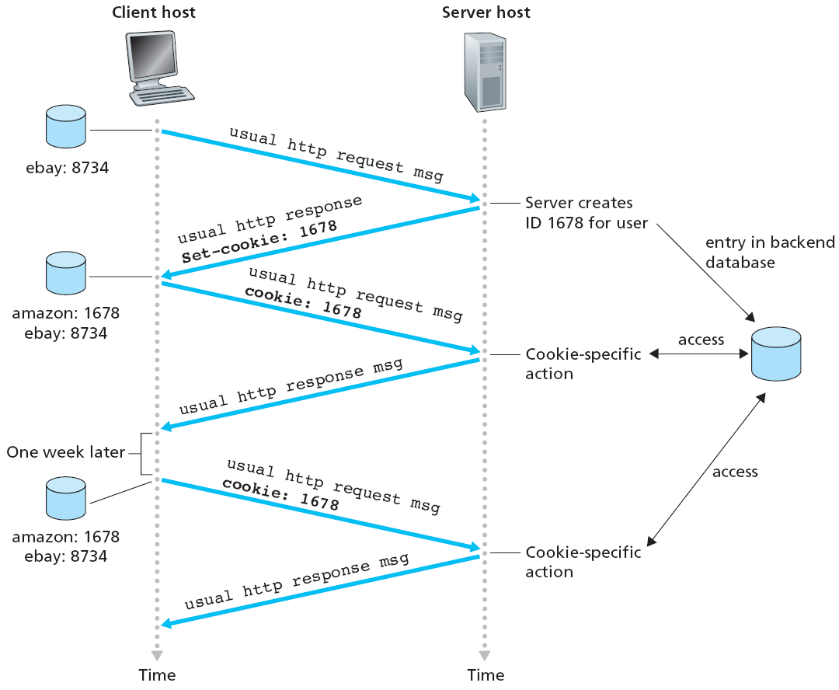
Cookies: keeping “state”

Slide 24
Cookies
What cookies can be used for…
authorization
shopping carts
product recommendations
user session state
(Web e-mail)
cookies and privacy…
cookies permit sites to learn about you…
  you may supply:
  name, e-mail, account info
info may be misused

Slide 25

Web caches (proxy server)
Goal: satisfy client request without involving origin server
user sets browser…
access web via cache
browser sends all HTTP requests to cache
  if, object in cache,
  cache returns object
  else, cache requests object from origin server, then returns object to client
proxy
server
HTTP request
HTTP request
client
HTTP response
HTTP response
origin
server
HTTP request
HTTP response
client

Slide 26
More about Web caching
Cache acts as both client and server
  as server, to original
  requesting client
  as client, to origin server
Typically, cache is installed
by ISP
(university, company, residential ISP)
Limitation…
copy of cached object may be stale…
Why Web caching…?
reduce response time
for client request
reduce traffic
on institution’s access
link

Slide 27
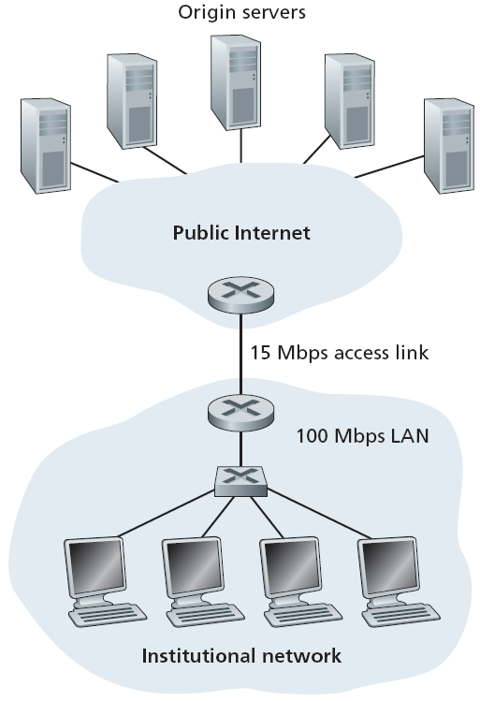
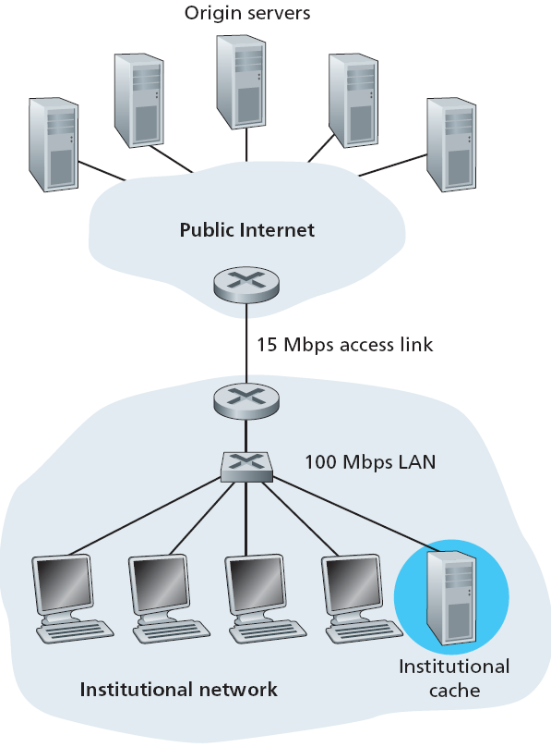
More about Web caching
Bottleneck between institutional network & Internet
Cache added to institutional network

Slide 28
Conditional GET
cache
server
client
Cache: specify date of cached copy in HTTP request
  If-modified-since: <date>
Server: response contains no object if cached copy is up-to-date:
  HTTP/1.0 304 Not Modified
Goal: don’t send object if cache has up-to-date cached version
  no object Tx delay
  better link utilization
HTTP request msg
If-modified-since: <date>
object
not
modified
since
<date>
HTTP response
HTTP/1.0
304 Not Modified
HTTP request msg
If-modified-since: <date>
object
modified
since
<date>
HTTP response
HTTP/1.0 200 OK
<data>

